Slide 1
Performance Tuning ASP.NET Applications
Software Test & Performance Conference
April 17 - 19, 2007
Part II

Slide 2
Introduction
Thomas O’Mara, President
  TEOInnovations, Inc.
  Microsoft Certified Professional
    C# Windows Application Development
    C# Web Based Application Development
    Visual Basic 6.0 Distributed Application Development
  thomaso@teoinnovations.com
  www.teoinnovations.com

Slide 3
Relevant Experience
Countrywide Home Loans
  IBM AS/400 Evaluation – PETE scripts
  AS/400 Advanced Server (4, 8, 12 CPU)
  900 Users - 5250 emulators
Kinko’s Corporate
  AMS (Web Application) Scalability testing
  Segue Silk Performer
  2 Compaq Proliant dual Xeon CPU’s
  HP9000/HP-UX 4 CPU DB Server (Informix)
  1500 Users
Amgen
  Licensing Application Evaluation
  Load Runner 8.1
  Windows Server 2003/IIS 6.0
  UNIX/Oracle 9.x
  50 Users

Slide 4
Relevant Experience
Fiserv/XP Systems
  Credit Union Application (ASP.NET)
  Load Testing Environment
    Mercury Astra Load Test v5.4.3
    Load Runner v7.5
  Performance Benchmark and Scalability Initiative
  5 Dell 2650 dual CPU Xeon servers
  IBM RS6000/AIX 5.x, 8 CPU, 52 HDD’s DB Server (DB2 UDB)
  Running 300 virtual users at 10 TPS with an average response time < 2 seconds.

Slide 5
Attendee Demographics
Managers – Insight into the ASP.NET technology.
Architects – Insight into application architectural design from a performance standpoint.
Developers - Insight into an object - oriented implementation from a performance standpoint.

Slide 6
Talk Overview
Objectives
  Provide by example and notes: ASP.NET application performance tuning from an overall system standpoint utilizing “Best Practice” development techniques and real time system monitoring.

Slide 7
Technologies
Windows Server 2003/IIS 6.0
.NET Framework 1.1/2.0
ASP.NET 1.1/2.0
Mercury Load Runner 8.1

Slide 8
Performance Counters
Performance counters are essential to obtain the necessary feedback as the application performs in real-time. The performance monitor tool in the Windows based server systems provides a number of counters to analyze the various aspects of the system and application.
TIP: To get the most out of the display in the Performance monitor tool, view the counters in the Report View. This reduces the chaotic look of the graph as a function time. Furthermore, you can just display a select number of counters in the graph view next to the report view. Works well for real time analysis.

Slide 9
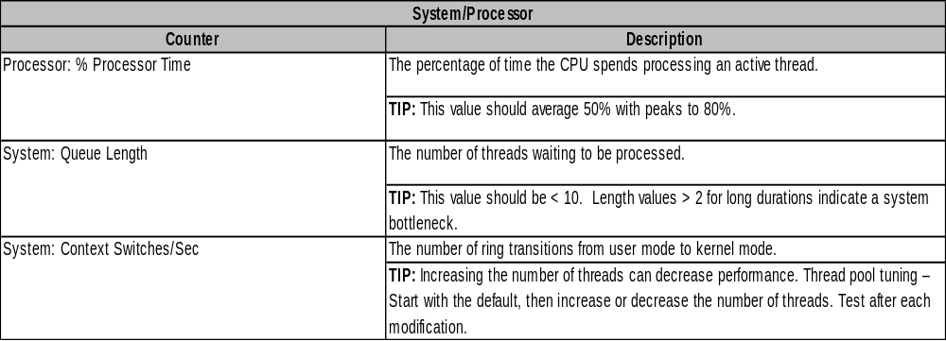
Performance Counters

Slide 10
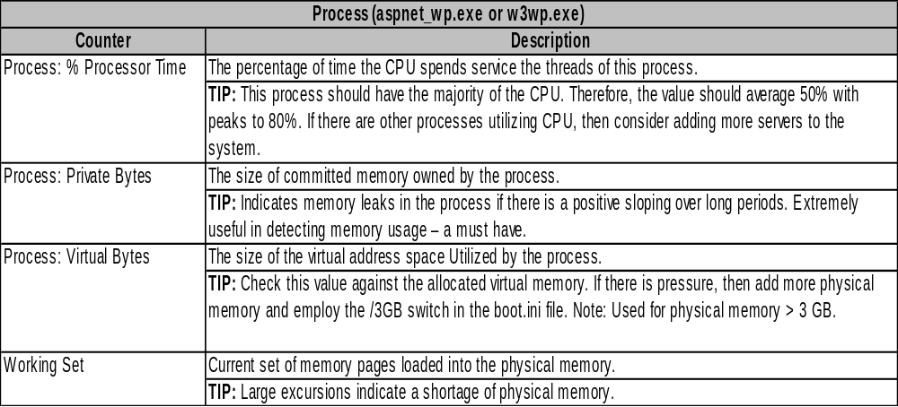
Performance Counters

Slide 11
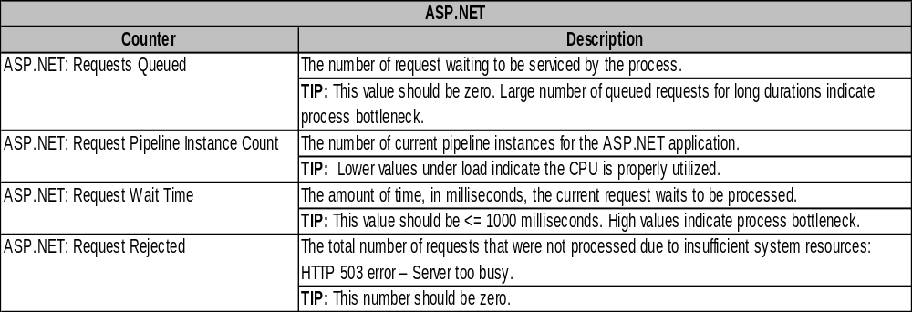
Performance Counters

Slide 12
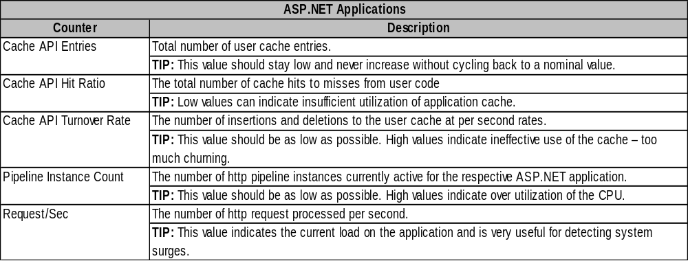
Performance Counters

Slide 13
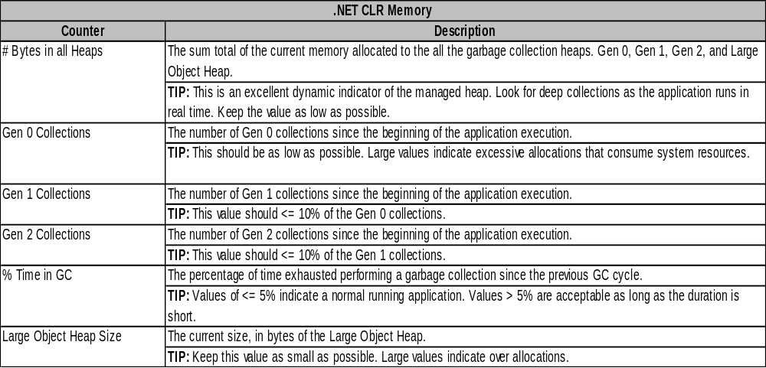
Performance Counters

Slide 14
Performance Counters
Testing Software (Demonstration)
  Load Runner 8.1
  Web Based Application
    Northwind Traders database
  Object Oriented Framework
    Inversion of Control (Late Binding Management)
    NHibernate
      ORM (Object Relational mapping)

Slide 15
Performance Counters
TIP: On a normal system the CPU is well behaved and has slight excursions above and below average. If the system is under load and surging, the CPU usage will track the Requests/Sec with long durations at high values to service the requests. This is due to periodic system resource contention initiated from the load test engine.
TIP: Typical data driven web sites do not require large amounts of disk space, but the performance can be affected by virtual memory churning. Look at the disk I/O counters and the Process – Virtual Bytes to see if there is any pressure in that area.
TIP: Shipping the data payload back and forth across the network can have some performance affects as a function of bandwidth utilization. The Network Monitor tool provided in the Windows server series can be extremely helpful pinpointing transportation bottlenecks. Also keep in mind, file sizes and transfer rates. These can be surprising. Know your target hardware.

Slide 16
Data Analysis
Report Types
  Running Virtual User profile
    Indicates user initiation ramp, steady state, user completion ramp as a function of time.
  Average Transaction Response Time
    Indicates the latency value of a completed transaction.
  Completed Transactions per Second (TPS)
    Indicates the amount throughput as a function of time.
  Server Performance Counters (Web, DB)
    Indicates the resources utilized as a function of time.
  Note: These values should be synchronize with a common time base.

Slide 17
Data Analysis
Report Audience
  Executive
  Business Users/Customers
  Project Managers
  Application Architects/Designers
  Application Developers

Slide 18
Data Analysis
Raw data extraction (Source and Target)
  Load Runner (LR) Data
    The LR application stores the results data real-time for use in report generation. The raw data can be exported to an Excel spreadsheet.
    Using the Excel analysis functions, the data can be viewed from various statistical standpoints (VAR, SD, and Freq Dist).
  Application Server
    LR provides a mechanism to acquire the app server resource performance counters in real time.
  Database Management Server
    LR provides a mechanism to acquire the database management resource performance counters in real time.

Slide 19

Data Analysis
Variance
  The variance of a random variable is a measure of its statistical dispersion, indicating how far from the expected value its values typically are.
  General Form:
  Note: statistical dispersion (also called statistical variability) is quantifiable variation of measurements of differing members of a population within the scale on which they are measured.

Slide 20

Data Analysis
Standard Deviation
  The standard deviation is a measure of the degree of dispersion of the data from the mean value. Also, the standard deviation is defined as the square root of the variance. This means it is the root mean square (RMS) deviation from the average.
  General Form:
  Note: In a normal distribution, about 68% of the scores are within one standard deviation (One Sigma) of the mean and about 95% of the scores are within two standards deviations (Two Sigma) of the mean.

Slide 21
Data Analysis
Frequency Distribution
  A frequency distribution shows the number of observations falling into each of several ranges of values. Frequency distributions are portrayed as frequency tables, histograms, or polygons.
  Frequency distributions can show either the actual number of observations falling in each range or the percentage of observations. In the latter instance, the distribution is called a relative frequency distribution.

Slide 22
Data Analysis
TIP: Standard deviation and Variance will indicate the variability in the data. How well the system is reacting under load, tight data groupings or wild excursions. Small values indicate a well behaved system.
TIP: Frequency distributions will indicate where the critical values are with respect to entire data population. Excellent choice for specifying application response time ranges within a set of normal distribution probabilities (i.e. 1 sigma, 2 sigma, etc…).

Slide 23
Data Analysis
Demonstration

Slide 24
Questions and Answers
Contact information
  thomaso@teoinnovations.com
  www.teoinnovations.com
Questions - ??????

Slide 25
References and Links
Mercury – Load Runner 8.0
  http://www.mercury.com
Software Testing and Performance Engineering
  http://www.perfeng.com
Internet Information Server 6.0
  IIS 6.0 Documentation (TechNet)
.NET Framework 1.1
  http://msdn.microsoft.com/netframework
ASP.NET
  http://msdn.microsoft.com/asp.net/

Slide 26
Related Related White Papers, Articles, and Documentation
Mercury Load Runner
  Tips and Tricks for Configuration, Scripting, and Execution.
  Load Testing to Predict Web Performance.
.NET Framework
  Garbage Collector Basics and Performance Hints.
  Garbage Collection: Automatic Memory Management in the Microsoft .NET Framework
  Garbage Collection—Part 2: Automatic Memory Management in the Microsoft .NET Framework
ASP.NET
  Underpinnings of the Session State Implementation in ASP.NET.
  Cutting Edge The ASP.NET View State.
  HTTP Pipelines Securely Implement Request Processing, Filtering, and Content Redirection with HTTP Pipelines in ASP.NET.

Slide 27
Related Related White Papers, Articles, and Documentation
Performance Tuning - .NET Framework
  ASP.NET Performance Overview
  Performance Tips and Tricks in .NET Applications
  .NET Framework General Reference: Memory Performance Counters
  Performance Considerations for Run-Time Technologies in the .NET Framework
  Boosting the Performance of the Microsoft .NET Framework
  Garbage Collector Basics and Performance Hints
  Writing High-Performance Managed Applications : A Primer
  Production Debugging for .NET Framework Application
Performance Tuning – ASP.NET
  .NET Framework Developer's Guide: Performance Counters for ASP.NET

